Slide 1
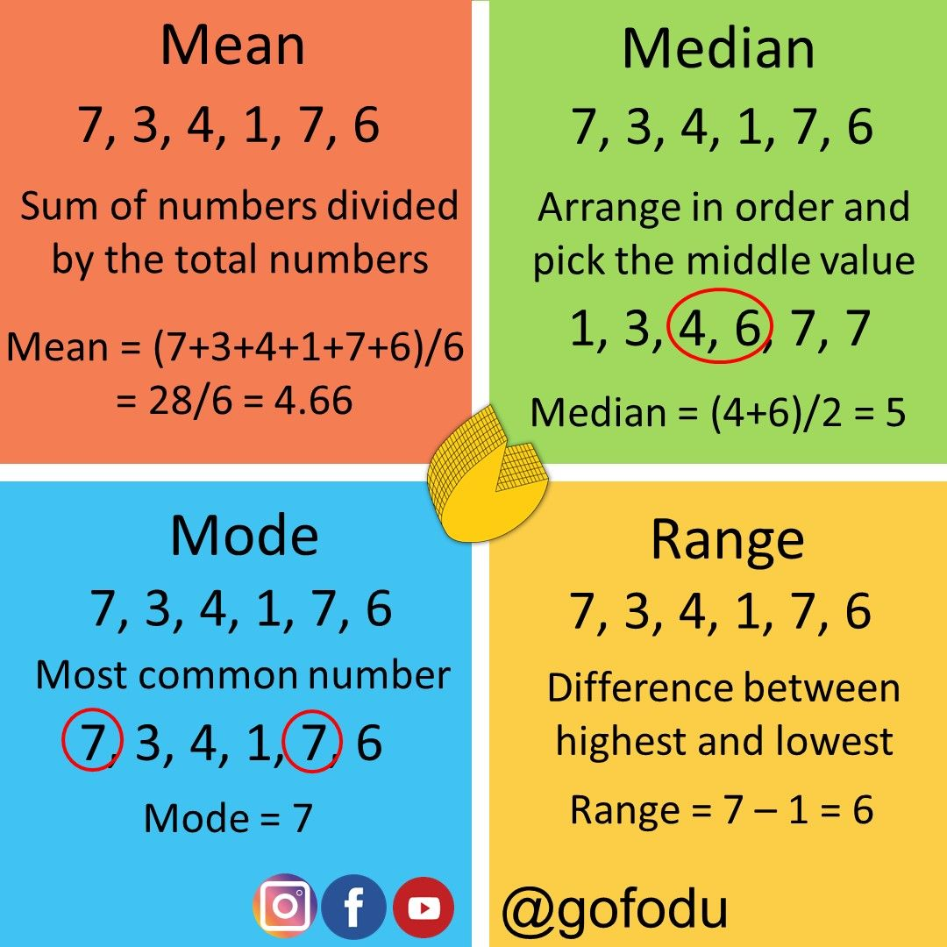
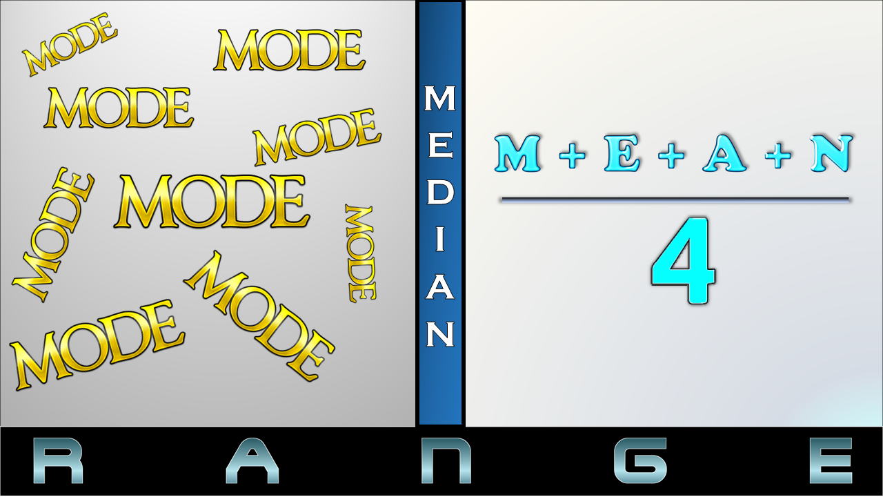

Slide 2
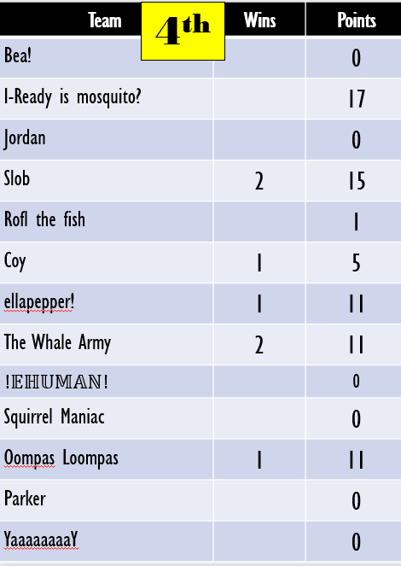
MEAN
MEDIAN
MODE
RANGE

Slide 3
MEAN
MEDIAN
MODE
RANGE

Slide 4
MEAN
MEDIAN
MODE
RANGE

Slide 5
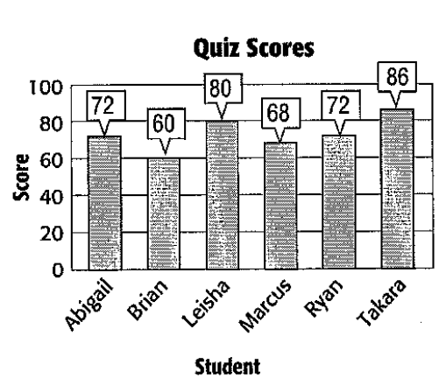
MEAN
MEDIAN
MODE
RANGE

Slide 6
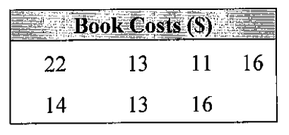
MEAN
MEDIAN
MODE
RANGE

