Slide 1
Tuesday, 3/02/2021
Learning Target:
I can:
REMINDERS:
TEST ON CIRCLES AND COMPOUND/CUT-OUT AREA FRIDAY 3/05
Agenda:
Study Guide
Cut-Out Area Review
Find the area of composite and cut-out shapes.
Composite & Cut-Out Area Guided Practice

Slide 2
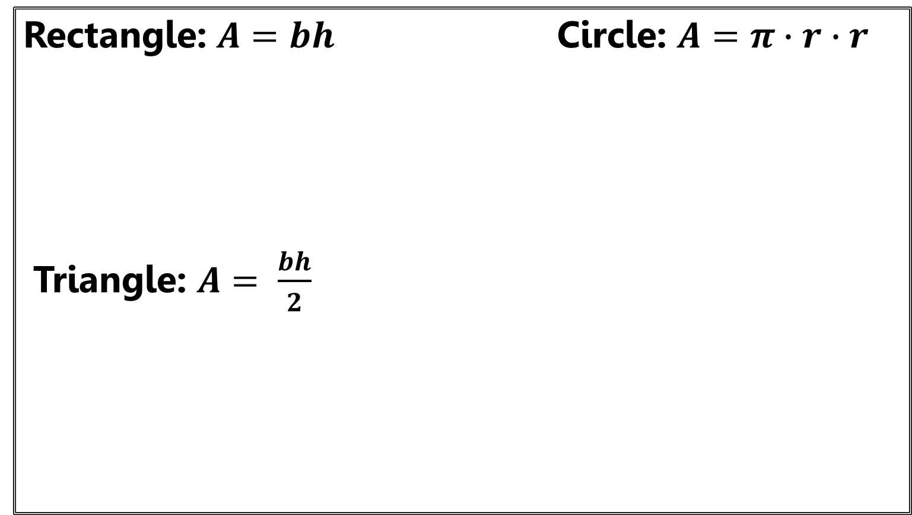
Area Formulas
Rectangle: $A=bh$ Circle: $A=π∙r∙$ $r$
Triangle: $A= \frac{bh}{2}$
r
$$h$$
$$b$$
$$h$$
$$h$$
$$b$$
$$b$$

Slide 3
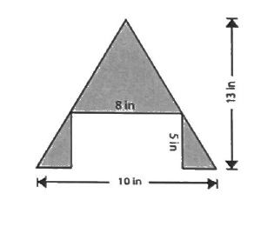

Slide 4
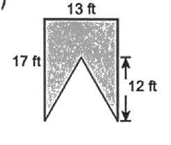

Slide 9
