Slide 1
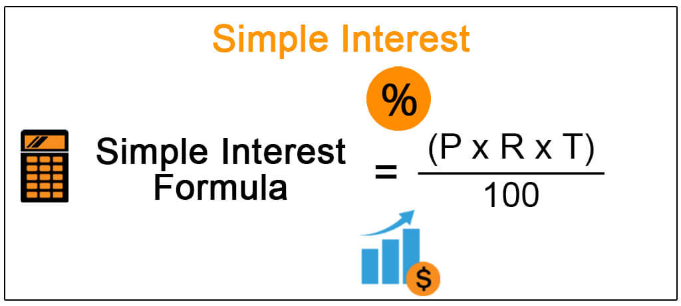

Slide 2
Simple Interest
Carmen earns 4.5% interest on an investment of $6000 each year. How much interest will she earn after six years?
Steps to find interest:
Find 4.5% of $6000
4.5% of $6000 is 270
Multiply that number by 6
270 x 6 = 1620
Carmen will earn $1620 in interest after six years.

Slide 3
Nt
Principal – the amount you start with
Rate – the percent (%) interest (interest rate)
Time – how long it happens

Slide 4
Isla took out a loan to buy baby things. She borrowed $400 at an interest rate of 5.5%. How much interest will she pay after 9 years?
Principal = Rate = Time = ANSWER:

Slide 5
Hank put $350 in a savings account 24 years ago. He earned 1.5% interest from the initial amount per year. How much interest did Hank earn?
Principal = Rate = Time = ANSWER:

Slide 6
Fred put $250 in a savings account 14 years ago. He earned 0.5% interest from the initial amount per year. How much money is in Fred’s savings account now?
Principal = Rate = Time = ANSWER:

