Slide 1
Perimeter

Slide 2
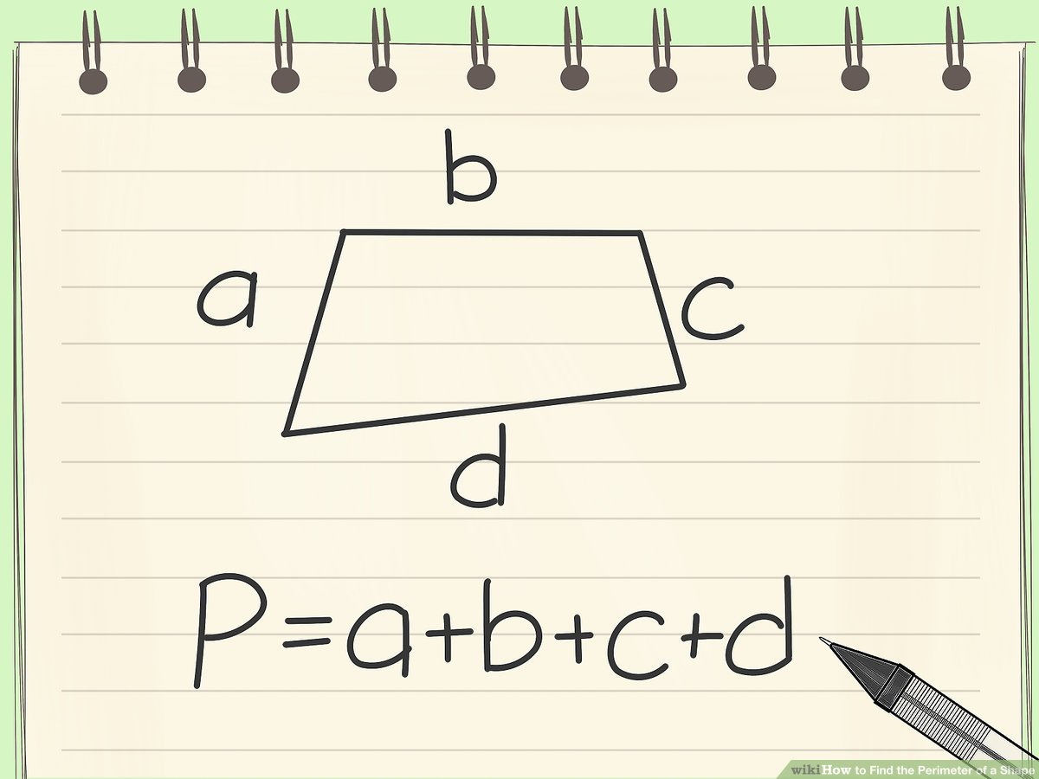
Perimeter The total length of all sides

Slide 3
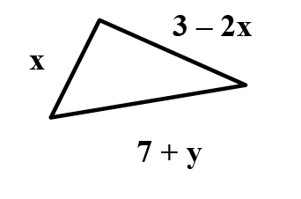
To find the perimeter for this triangle, all we need to do is add the three sides together.
What this becomes is Combining Like Terms
x + 3 – 2x + 7 + y
-x + 10 + y

Slide 4
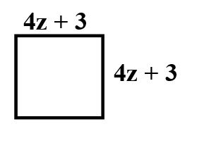
Since a square has 4 equal sides, the perimeter could be found by using the Distributive Property
4(4z + 3)
(4 x 4z) + (4 x 3)
16z + 12

