Slide 1
Percent Proportion

Slide 2
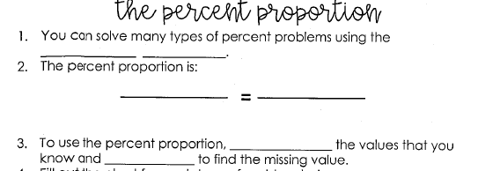
PERCENT
PROPORTION
PART (IS)
PERCENT (%)
WHOLE (OF)
100
PLUG IN
CROSS MULTIPLY & DIVIDE

Slide 3
PROPORTION

Slide 4
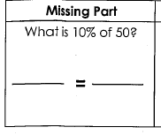
EQUATION
SOLVE
X
10
50
100

Slide 5
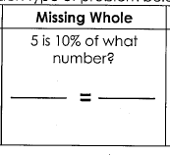
5
10
X
100

Slide 6
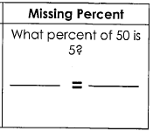
5
X
50
100

Slide 10
