Slide 1
Discounts & Markups
Thursday, 01/07/2021

Slide 2
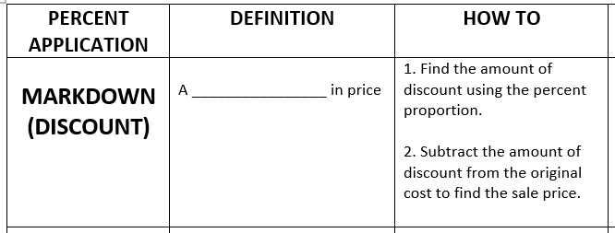

Slide 4
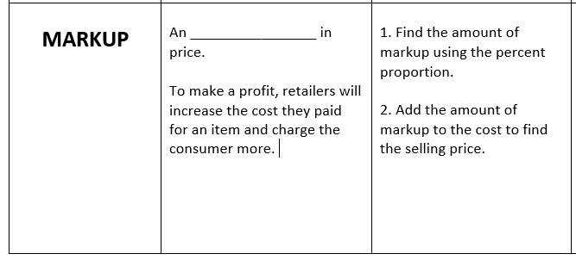

Slide 6
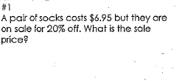

Slide 7
