Slide 1
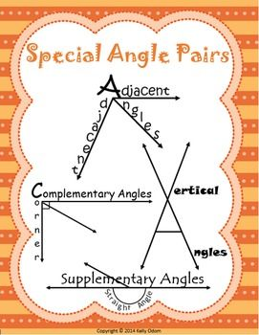

Slide 2
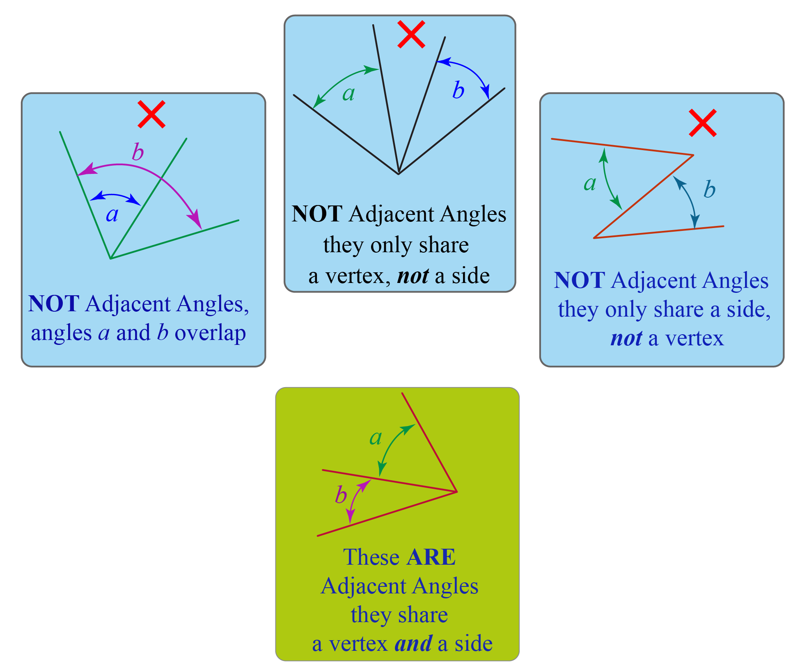

Slide 4
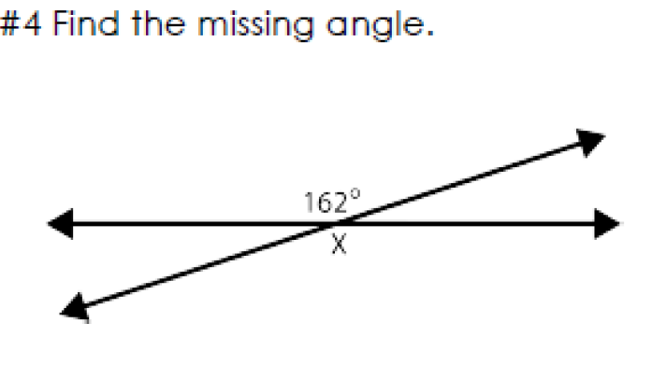
Vertical angles will ALWAYS equal 180 degrees.
1

Slide 5
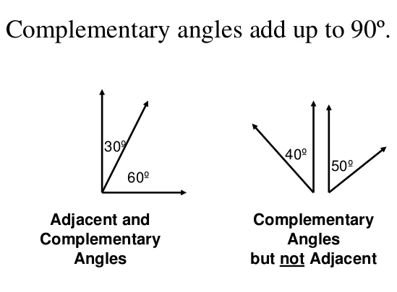
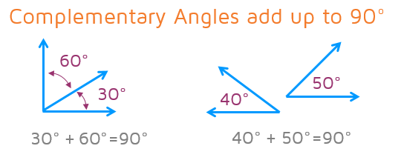

Slide 6
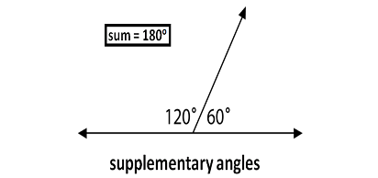
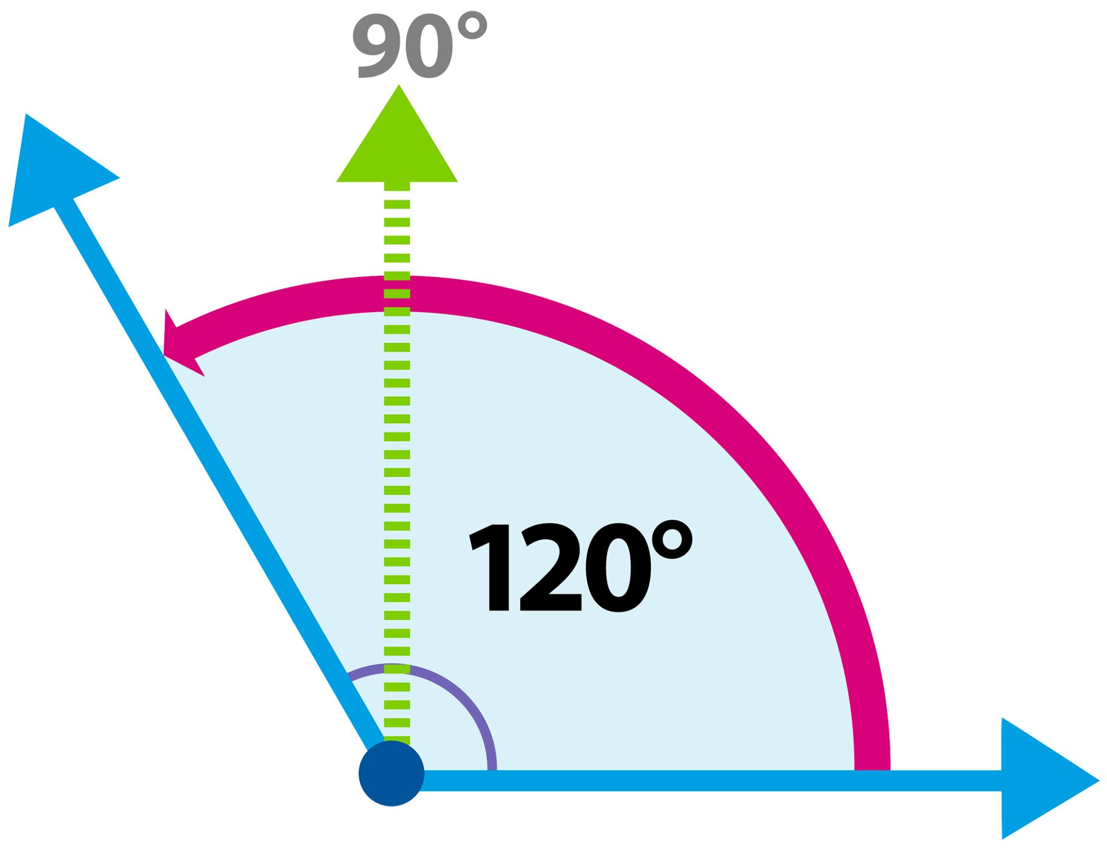
Two obtuse angles can never be supplementary.

Slide 7
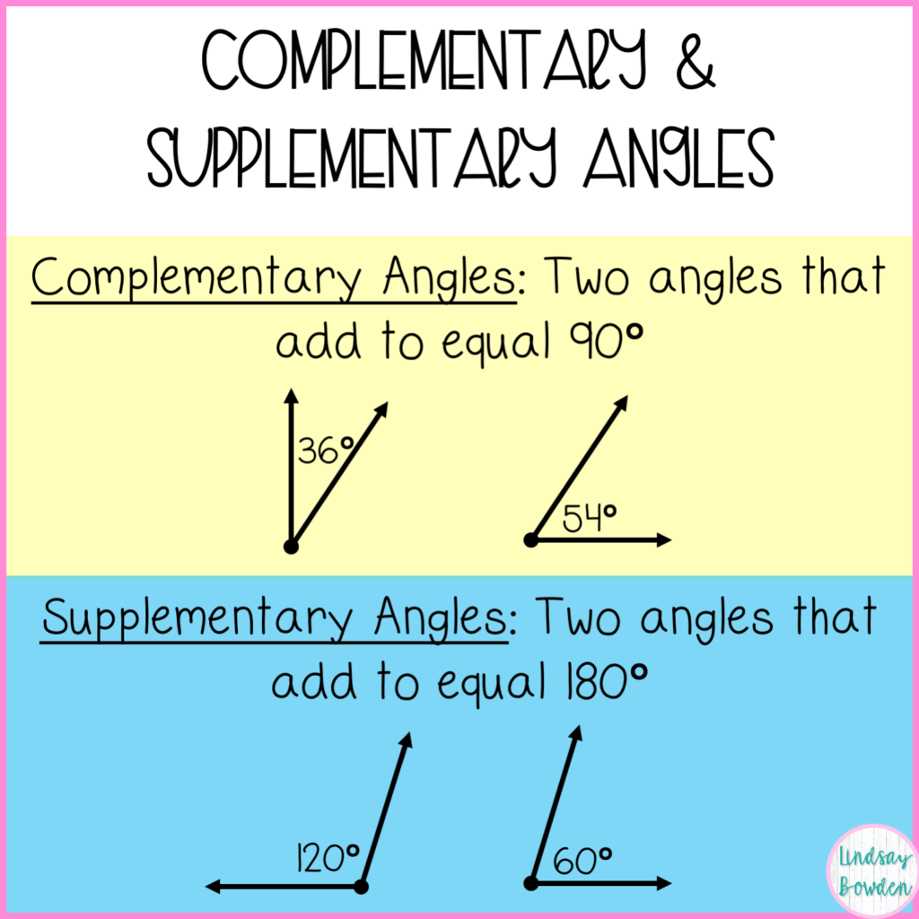
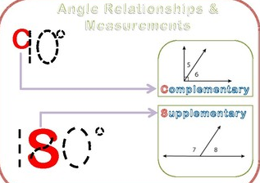
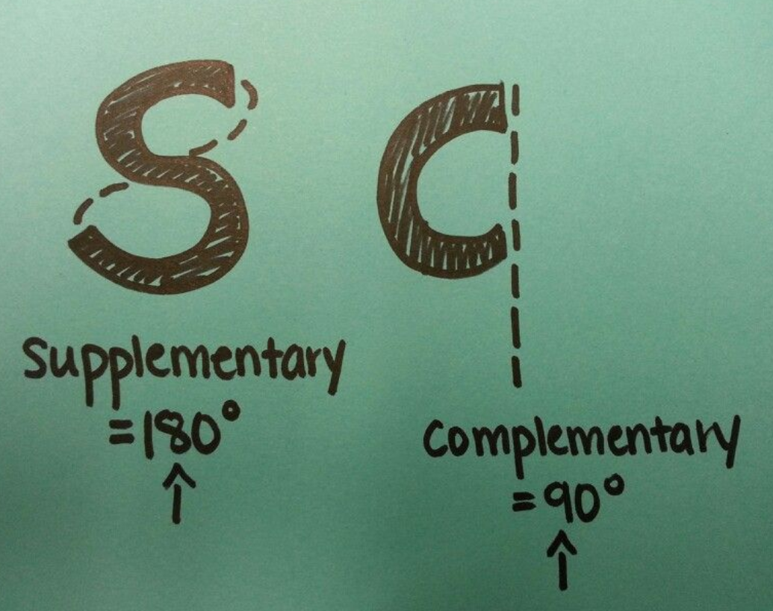

Slide 8
Two obtuse angles can never be supplementary.

Slide 10
Name the Angles (answers on next page)
Name the Angle Pair A+B (answers on next page)

Slide 11
Name the Angle Pair A+B (answers on next page)
Supplementary
Adjacent
vertical
Complementary
Adjacent
Supplementary
Adjacent
vertical
Complementary
Adjacent

Slide 12
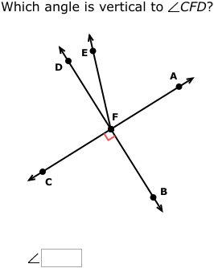
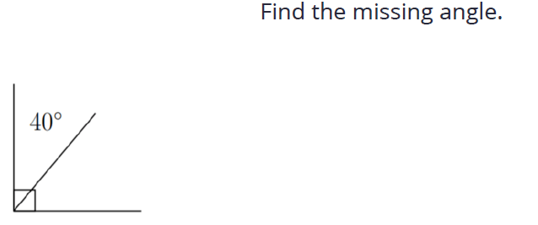
answers on next page

Slide 13
ANSWERS
X = 118
Angles 1 and 3
Vertical
X = 18
X
X = 50
X = 20
Angle BFA

